Slide 1
// include/linux/cdev.h
struct cdev {
struct kobject kobj;
struct module *owner;
const struct file_operations *ops;
struct list_head list;
dev_t dev;
unsigned int count;
} __randomize_layout;
// rust/bindings/bindings_helper.h
#include <linux/cdev.h>
// rust/bindings/bindings_generated.rs
#[repr(C)]
#[derive(Copy, Clone)]
pub struct cdev {
pub kobj: kobject,
pub owner: *mut module,
pub ops: *const file_operations,
pub list: list_head,
pub dev: dev_t,
pub count: core::ffi::c_uint,
}
// rust/kernel/chrdev.rs
/// Character device.
///
/// # Invariants
/// - [`self.0`] is valid and non-null.
struct Cdev(*mut bindings::cdev);
struct RegistrationInner<const N: usize> {
cdevs: [Option<Cdev>; N],
}
pub struct Registration<const N: usize> {
inner: Option<RegistrationInner<N>>,
}
impl Cdev {
fn alloc(……) -> Result<Self> {
// SAFETY: FFI call.
let c=unsafe{bindings::cdev_alloc()};
}
// rust/kernel/driver.rs pub trait DriverOps {
/// # Safety
/// `reg` must point to valid, initialised, and writable memory.
unsafe fn register(
reg: *mut Self::RegType,…) -> Result;
}
// samples/rust/rust_chrdev.rs
module! {
type: RustChrdev,
name: "rust_chrdev",
author: "Rust for Linux Contributors",
}
struct RustFile;
struct RustChrdev {
_dev: Pin<Box<chrdev::Registration<2>>>,
}
impl kernel::Module for RustChrdev {
fn init(……) -> Result<Self> { let mut chr = chrdev::Registration::new_pinned(……)?;
chr.as_mut().register::<RustFile>()?;
Ok(RustChrdev { _dev: chr })
}
}
impl Drop for RustChrdev {
fn drop(&mut self) {……}
}
(a)
(b)
(c)

Slide 2
// In C
struct elements {
int len; void* inner;
}; struct factory {
struct elements factory_inner;
};
struct factory thread_thread = {
.factory_inner = {
.len = 256, .inner = thread_ptr }
};
struct factory proxy_thread = {
.factory_inner = {
.len = 256, .inner = proxy_ptr }}
;
// In Rust
pub struct elements<const N: usize> {
inner: [i32; N],
} pub struct factory {
factory_inner: elements<8/256>,
}
let thread_factory = factory { factory_inner:
elements::< 8/256 > { inner: [0; 8/256] } }; let proxy_factory = factory { factory_inner:
elements::< 8/256 > { inner: [0; 8/256] } };
// In Rust but inflexible
pub struct elements<const N: usize> {
inner: [i32; N],
} trait dyn_num { // fn use_elements(&self); } pub struct factory {
factory_inner: &'static dyn dyn_num
}
struct thread<const T: usize>{
thread_elements: elements<T>,
} impl dyn_num for thread<256> {}
struct proxy<const T: usize>{
proxy_elements: elements<T>,
} impl dyn_num for proxy<8> {}
static thread_factory_inner: thread<256> = thread {
thread_elements: elements { inner: [0; 256] },
}; static proxy_factory_inner: proxy<8> = proxy {
proxy_elements: elements { inner: [1; 8] },
};
let thread_factory = factory { factory_inner:
&thread_factory_inner }; let proxy_factory = factory {factory_inner:
&proxy_factory_inner };
(a)
(b)

Slide 3
Study the RFL codes
Collect discussions and presentations
Analyze RFL issues and BUGs
Find RFL Linux kernel drivers

Slide 4
Collect and study RFL related data and materials
RQ1: What’s the status quo of RFL?
RQ2: Does RFL live up to the hype?
RQ3:Where the RFL will go in next?

Slide 5
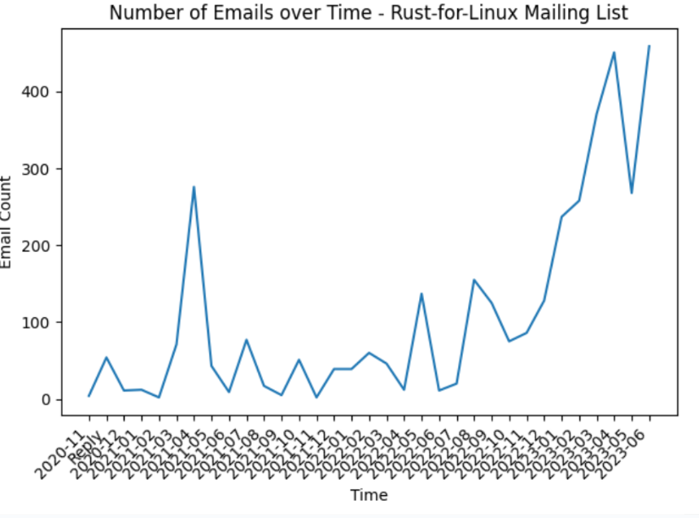
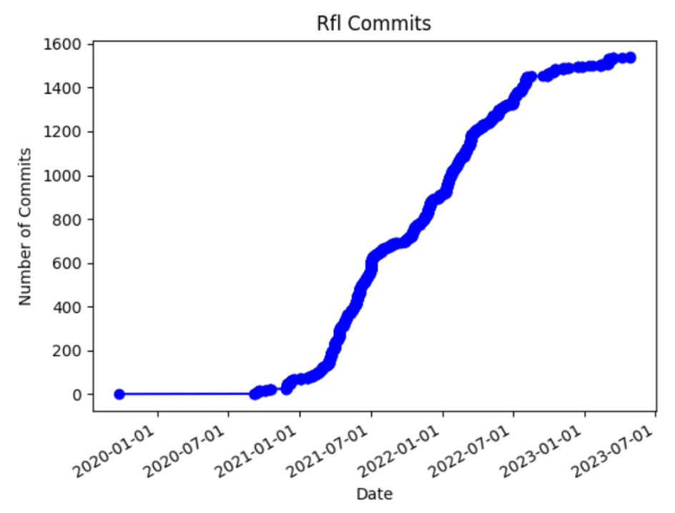
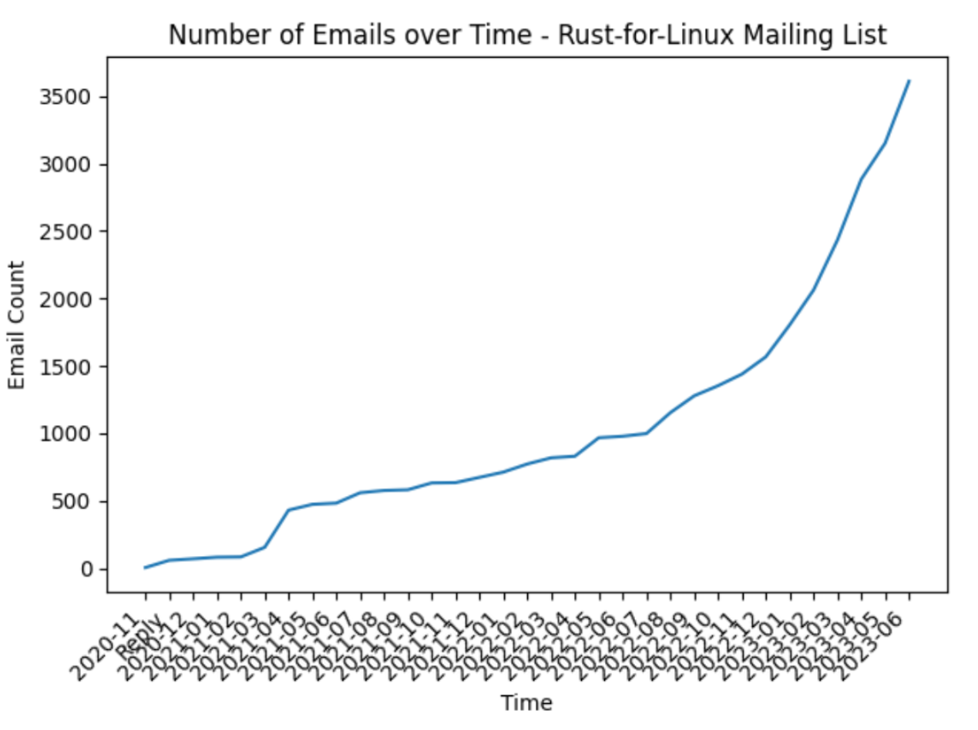
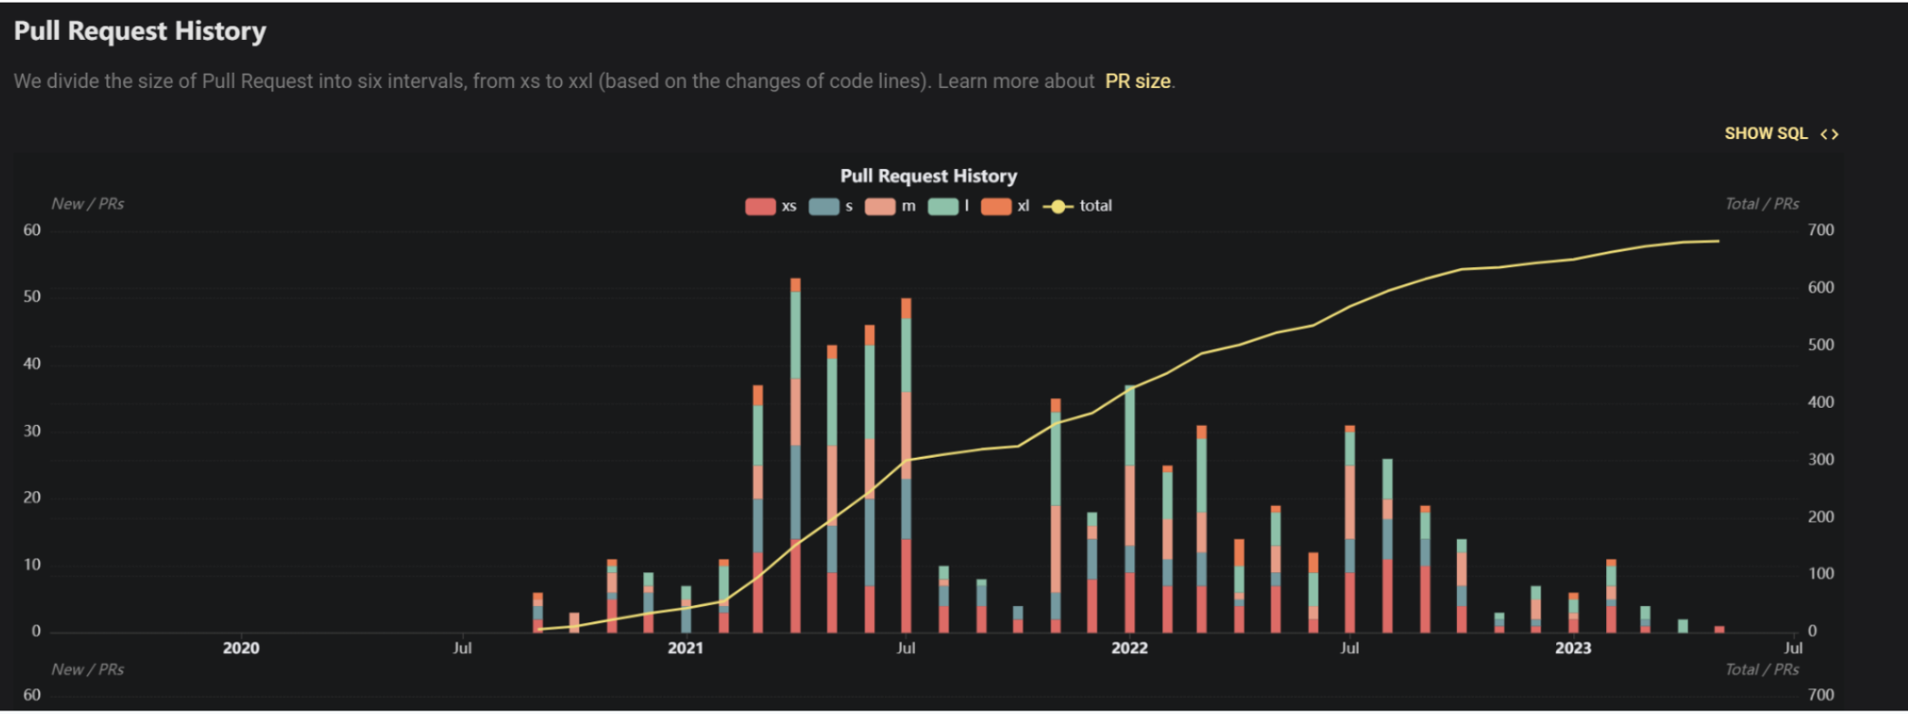
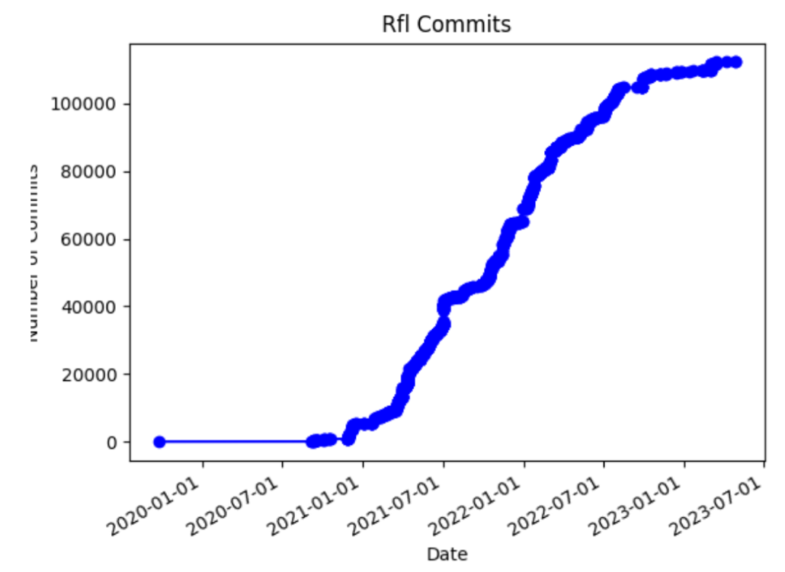
Sum of # 还是直接的 #
CoL
PR和社区的email肯定有重合 这个怎么说明

Slide 6
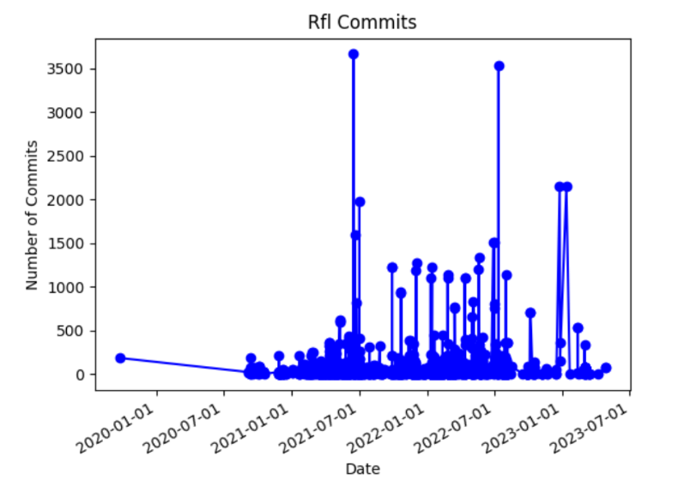
Sum of # 还是直接的 #
CoL
PR和社区的email肯定有重合 这个怎么说明

Slide 7
Sum of # 还是直接的 #
CoL
PR和社区的email肯定有重合 这个怎么说明

Slide 8
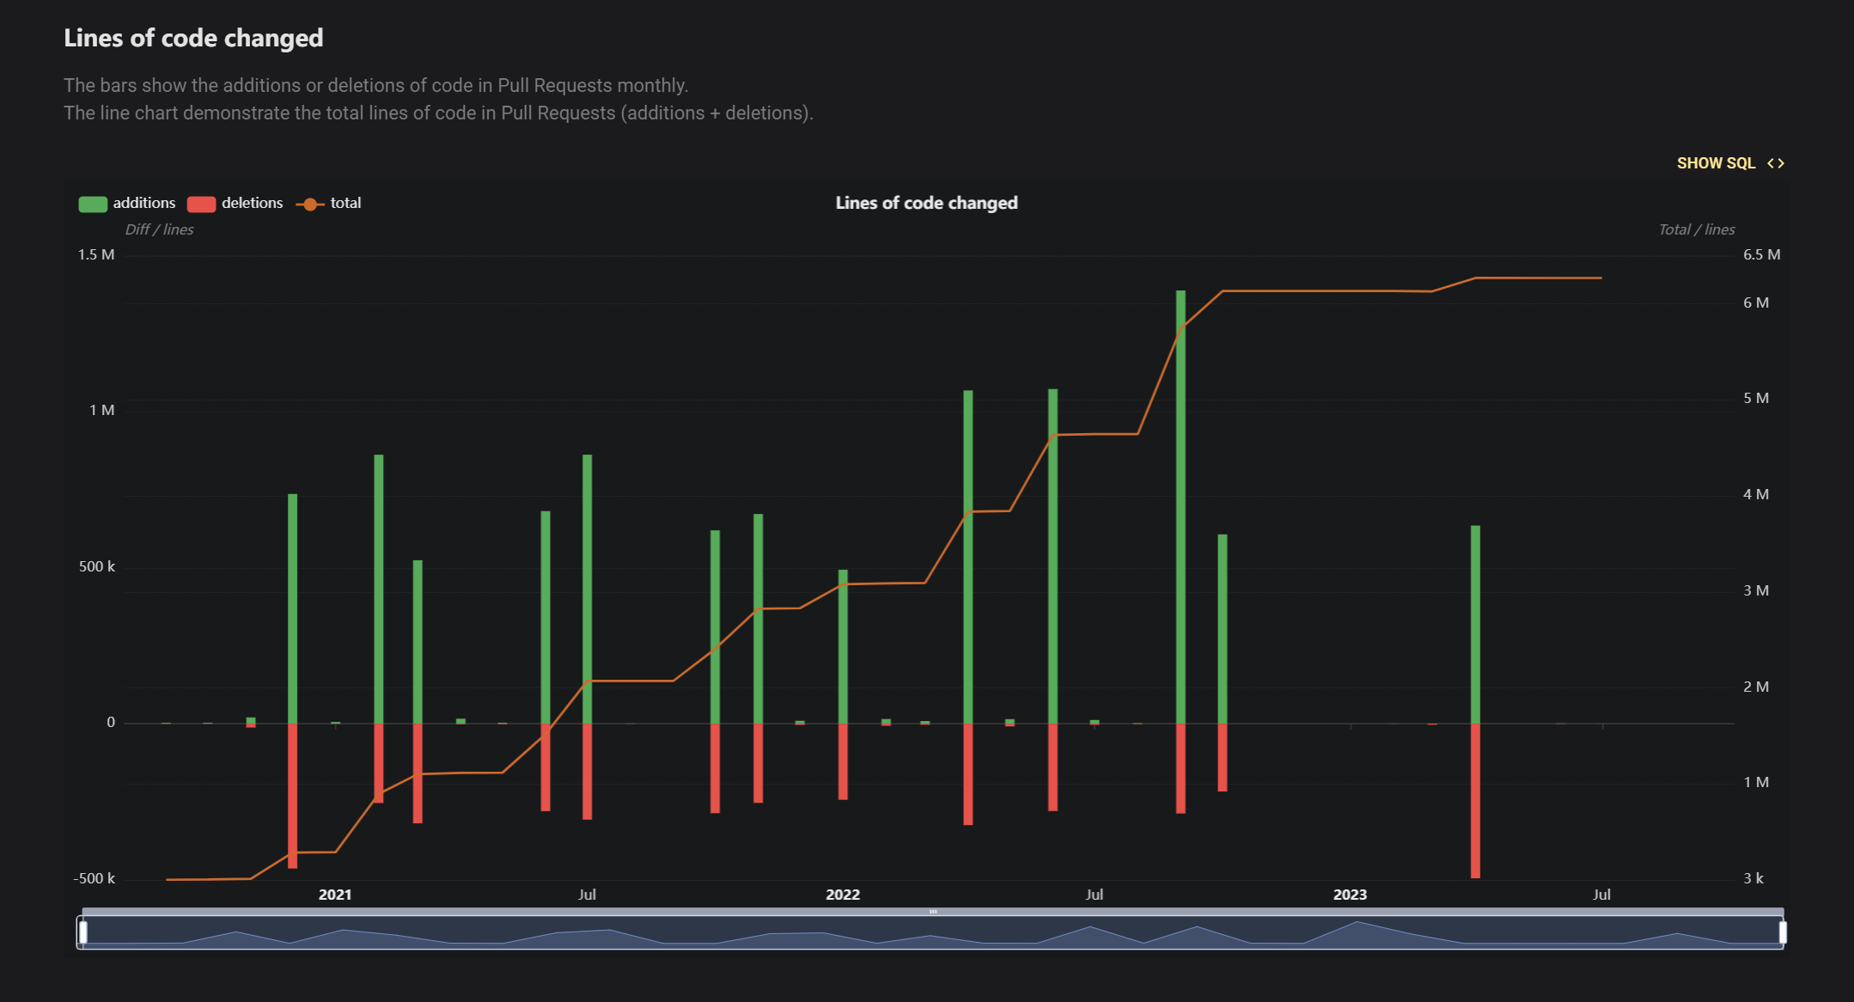
Sum of # 还是直接的 #
CoL
PR和社区的email肯定有重合 这个怎么说明

Slide 9
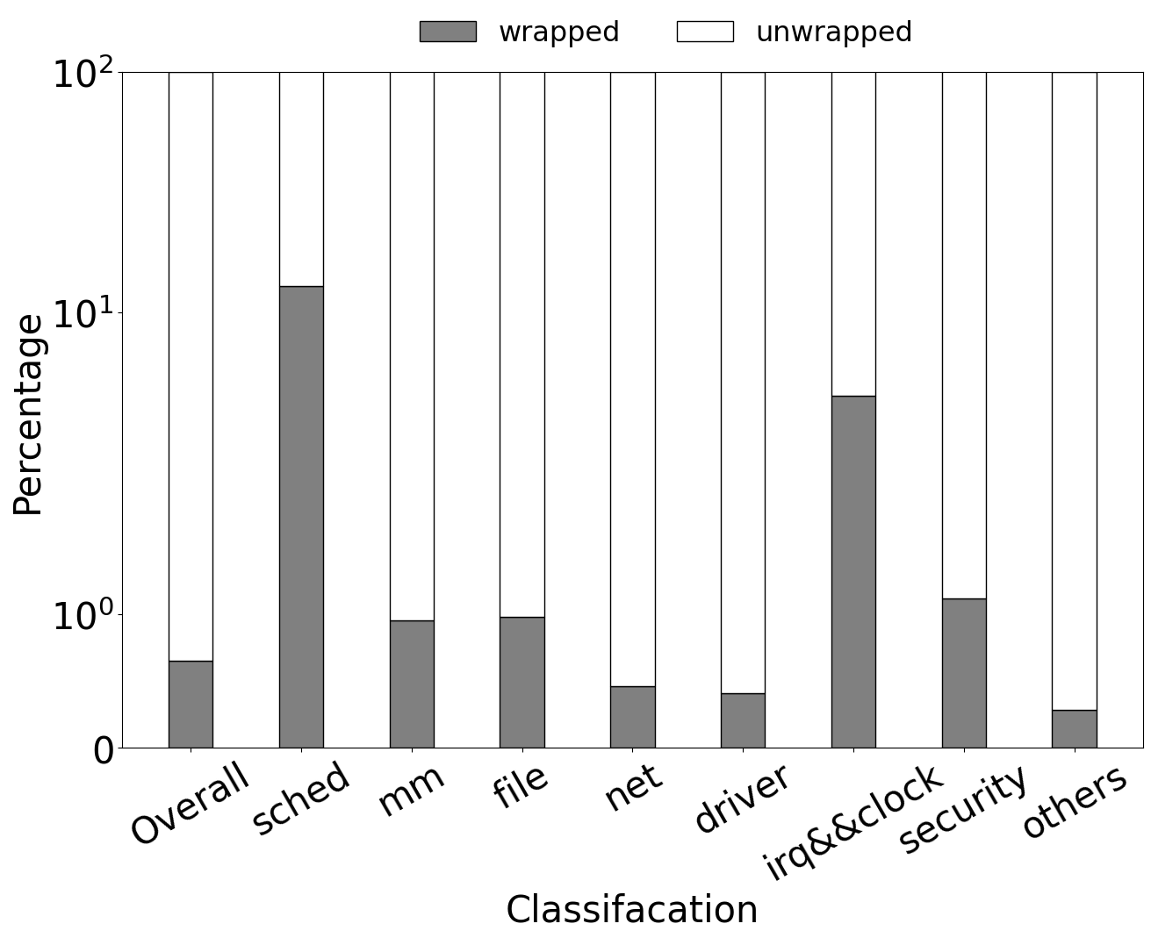
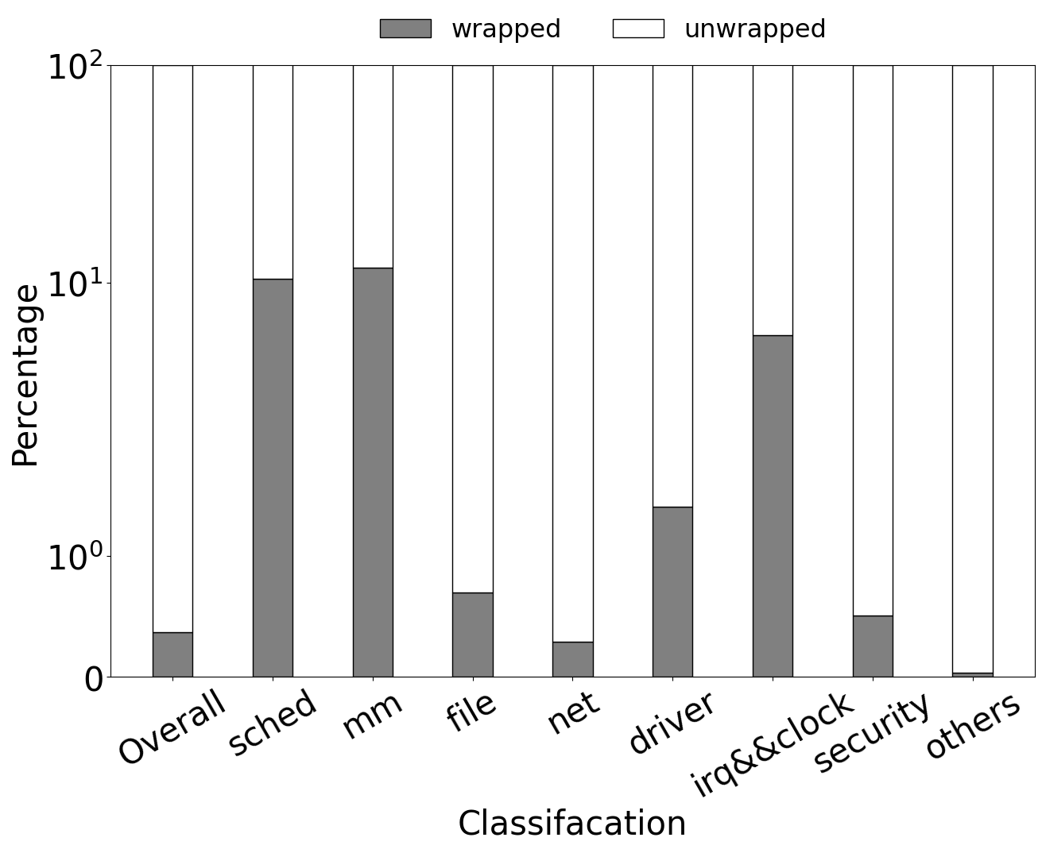
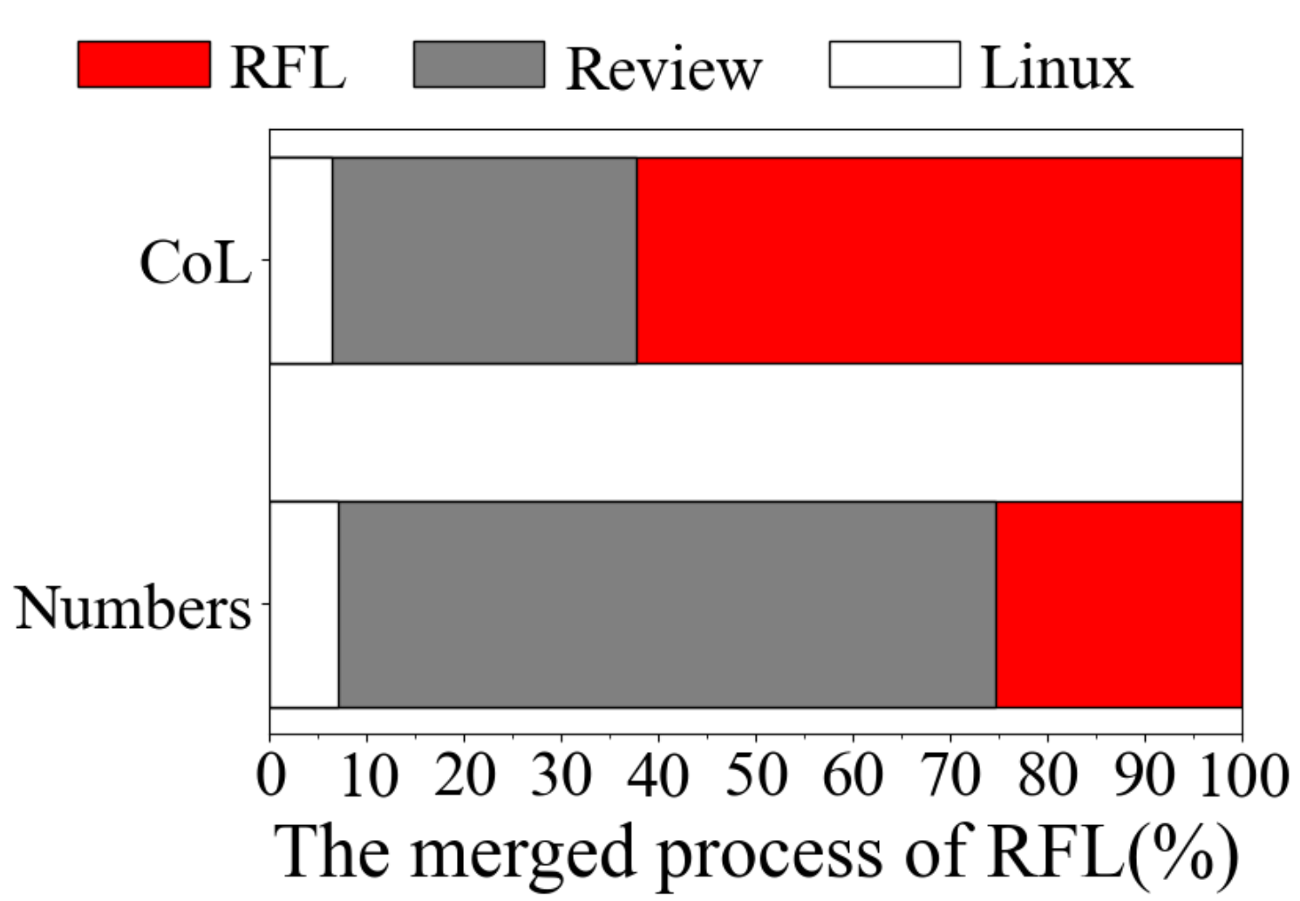
7.1%
37.6%
6.4%
74.6%
(a) The progress of the wrapped struts
(b) The progress of the wrapped functions
(c) The progress of the wrapped struts

Slide 10
7.1%
37.6%
6.4%
74.6%

Slide 12
RQ1: What’s the status quo of RFL?
Data structers
RQ3:Where the RFL will go in next?

Slide 14
(a) The percentage of different opinions
(b) The reasons

